Slide 1
India’s Best Corporate Training and Placement Assistance Platform for B. Tech and MBA students
Phoenix Global
MBA Certification Programs
2023
1 Month | Live Corporate Project with Industry Mentorship
Summer Internship Preparation | Guidance to Crack Case Competition
Phoenix Global
A One-stop Career Catalyst

Slide 2
About Us
Phoenix Global is a skill-development company that helps students acquire and master professional and soft skills as per the requirements of the industry benchmarked to world’s top firms, trained by top class industry professionals.
Phoenix Global is India’s firsts to have Industry professionals with esteemed alma mater including the IITs and IIMs to mentor and decipher the cutting-edge skills, critical to the emerging industries while also giving them an opportunity to intern on a project under the mentorship of industry professionals from the IITs /IIMs.
Our Reach
Institutes
Impact
Training Hours
Collaborations
5,00,000+
575+
50,000+
4,00,000+
100+
Students reached
Institutes reached
Careers transformed
Live Training Hours
IIT/IIM/NITs/Others
No. of Live Projects Provided (In 2022-23): 2750+

Slide 3
Our Clients,
Students,
Associations,
and
Knowledge Partners
are from
India’s Top B-Schools
Harvard HUII

Slide 4
About the Program
Phoenix Global’s Leadership Experience MBA Certification Program is India’s First Live MBA Leadership Program that focuses on Training and Mentoring 1st and 2nd Year MBA students to perform exceptionally during their summer internships, placements and early corporate career. It is a well curated 1 Month Program that provides a comprehensive experiential learning to the student through live training sessions, applied corporate projects and industry immersion in the domain of Brand Management, Product Management, Business Analytics and Digital Marketing
Program Highlights
Assured Corporate
Live Project to All
Certification
CV Points & Letter of Recommendation
Assured
Internship Opportunity to top 20%
Corporate Mentors with IIM Alma Mater
Project Review and Feedback
Live Mentorship Sessions
High 1-1 Focus
Placement Preparation
Experience needed to work in Top Companies
Cracking National Case Competitions
Chance to Grab Internship
Personal
Mentorship

Slide 5
Phoenix MBA students
will work on Applied
Live Corporate
Experience Projects/
mock SIP projects
at top companies
such as …

Slide 6
Available Tracks
Brand Management Program
Product Management Program
Business Analytics Program
Digital Marketing
Program
Excel in your dream SIP Program
(+Certification, LOR and CV Points)
Get Career Guidance, SIP Readiness Training & Project Feedback
Live Industry Training Sessions, Applied Corporate Projects with Live Mentorship
Apply to the Program and complete selection & Registration Process

Slide 7
What After You Join?
CV Points: Program Certificate, Live Project Certificate, LOR (Top 50%)
1-month self-paced live project under the guidance of Industry mentors
Live learning sessions on 1st weekend (Sat and Sun) at a convenient time
Students will be Divided in a group of 3-4 students & Projects will be briefed by Industry Mentors
Projects will be based on the existing problem statements / mock summer internship project titles of Companies such as

Slide 8
Brand Management Program (BMP)
Live Corporate Experience Projects
Additional Sessions/Training
Concepts you will Master
Branding Project for Godrej
Brand Management Project for a Cosmetics Product:
You need to do both primary and secondary research and understand consumer behavior to suggest and implement appropriate activation.
or
Branding Project for Asian Paints
Brand Repositioning the A category in B market:
Identification of brand opportunity, and create the positioning basis an exhaustive understanding of the consumers.
How to Ace Summer Internships Prep
Making the Most of effective CVs
Effective strategies to crack Interviews
Careers in Marketing and Sales
Brand Management Process and Strategy
Brand Architecture, Brand Positioning
Brand Identity Personality
Consumer Behavior and Neuro-Marketing
CBBE(Customer Based Brand Equity)Model
Developing Marketing Campaigns
Brand and Pricing power
Situations and Branding efforts.
Launching a New Product
Defending Against Competition
Competing against Private Label
Critiquing a Marketing Effort & Advertising
Getting Analytical : Estimation and RoI
Employer Branding
Social Branding
Takeaways and Resources
Live Corporate Project Certificate
Brand Management Program Certificate
Letter of Recommendation
Exclusive E-Book for SIP
300+ exclusive PPT templates

Slide 9
Product Management Program (PMP)
Live Corporate Experience Projects
Additional Sessions/Training
Concepts you will Master
Product Mgt Project for Amazon / Meesho
Market & Customer Understanding: Understand the reselling market and needs of resellers.
Problem Identification & Prioritization: Adopt a structured approach to identify what problems need to be solved
Solution Discovery: Facilitate a process to come up with the best technology-led ideas to solve the prioritized problems.
Go-to-Market Planning: Create a go-to-market plan working with business/marketing stakeholders to maximize product adoption and success.
Roadmap Creation: 3-month forward looking product roadmap creation
How to Ace Summer Internships Prep
Making the Most of effective CVs
Effective strategies to crack Interviews
Careers in Marketing and Sales
Introduction to Product Management
Conducting market Research
Competitor Analysis
Performing a feature audit
New feature ideation techniques
Prioritization of product features
Design for product managers
Getting your product features used
Performing product analytics
GTM Strategy
Building a go-to market strategy
Product Strategy - Introduction
Creating a great product strategy
Technology for product managers
Placements Orientation and Job Roles
Takeaways and Resources
Live Corporate Project Certificate
Product Management Program Certificate
Letter of Recommendation
Exclusive E-Book for SIP
300+ exclusive PPT templates

Slide 10
Digital Marketing Program (DMP)
Live Corporate Experience Projects
Additional Sessions/Training
Concepts you will Master
End – End Digital Marketing Project for a Startup
Design and deploy the DM strategy and execution for a new campaign launch
Work comprehensively on
Target Group
Insight
Proposition, Campaign Design
DM strategy
Hands On
Google Ads
Facebook Ads
Social media budgeting and paid digital marketing campaigns
How to Ace Summer Internships Prep
Making the Most of effective CVs
Effective strategies to crack Interviews
Careers in Marketing and Sales
Overview of Digital Marketing
Display Advertising
Search Advertising
Mobile marketing
Inbound Marketing
Facebook Marketing
LinkedIn Marketing
E-Mail Marketing
SMA, Web Analytics
Measuring Digital Campaign
CPC, CTR, CPM
Content Marketing
Viral Marketing
Search Engine Optimization (SEO)
Takeaways and Resources
Live Corporate Project Certificate
Product Management Program Certificate
Letter of Recommendation
Exclusive E-Book for SIP
300+ exclusive PPT templates

Slide 11
Important Dates and Details
Slot | Slot 1 | Slot 2 | Slot 3 | Slot 4
Dates and Timings for Live Sessions | 29-30 July | 5-6 Aug | 12-13 Aug | 19-20 Aug
 | (4pm-8pm) | (4pm-8pm) | (4pm-8pm) | (4pm-8pm)
BMP Program | ✔ | ✔ |  | ✔
PMP Program | ✔ |  | ✔ | ✔
SLP Program |  | ✔ |  | ✔
DMP Program | ✔ |  | ✔
Program Certificate Issue Date | 31-Jul | 07-Aug | 14-Aug | 21-Aug
Project Submission Deadline | 15-Aug | 22-Aug | 29-Aug | 05-Sep
LOR, Awards, etc Issue | 07-Sep | 07-Sep | 07-Sep | 07-Sep
Note: Session Recordings will be provided for students who cannot attend the program due to any unavoidable reasons

Slide 12
Why Choose Phoenix?
Takeaway
MarkAcademy
Competitors
MOOC/Others
Mentorship Sessions | Live Sessions | Recorded Videos | Recorded Videos
Live Guest Lectures by Industry Professionals | Yes | No | No
Internship Readiness Training | Yes | No | No
Applied Live Experiential Projects | Yes | No | No
Live Project Included | Yes | No | No
Recorded Sessions for Revision | Yes | No | No
Program Fee | < INR 5k | > INR 20K | > INR 1L +

Slide 13
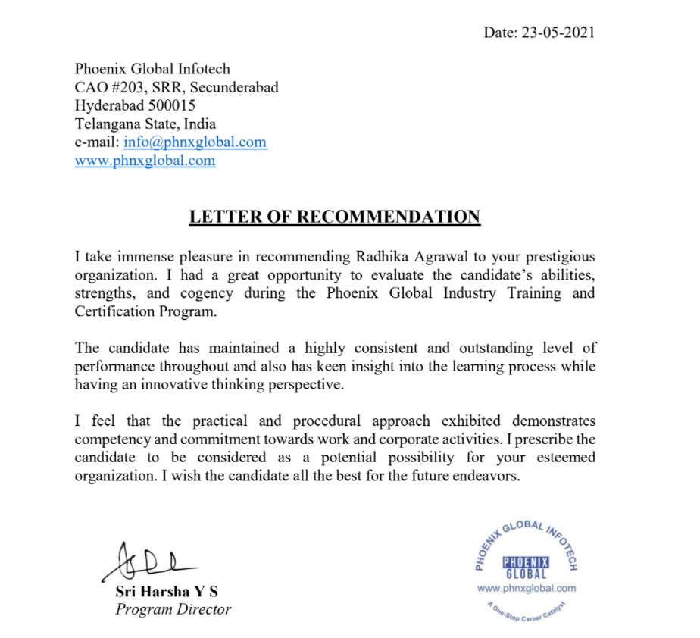
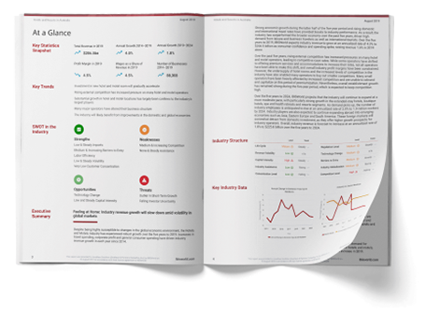
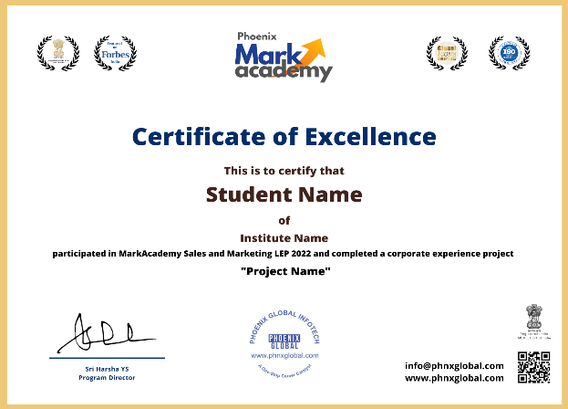
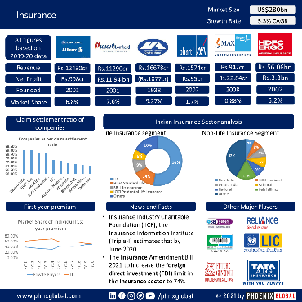
Takeaways
Sample Certificate
Sample LOR
Live Project Report
300+ Free PPT Templates for SIP
Free Customized Marketing and Sales E-Book

Slide 14
Testimonials of Phoenix Alumni

Slide 15
Testimonials of Phoenix Alumni

Slide 16
Testimonials of Phoenix Alumni

Slide 17
Testimonials of Phoenix Alumni

Slide 18
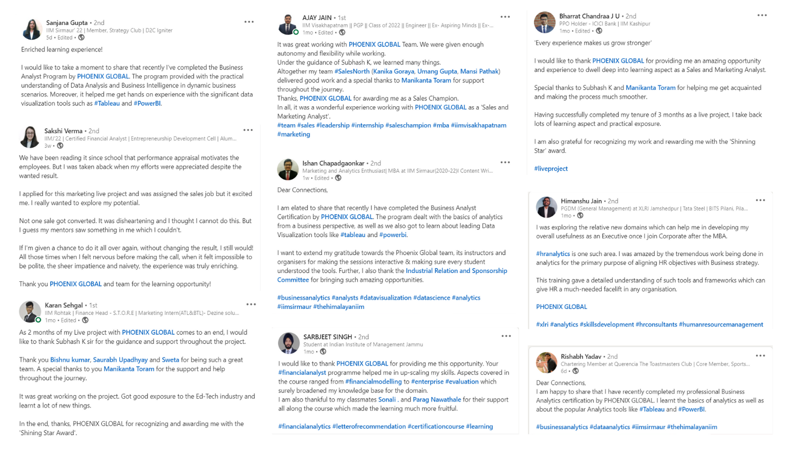
Success Stories

Slide 19
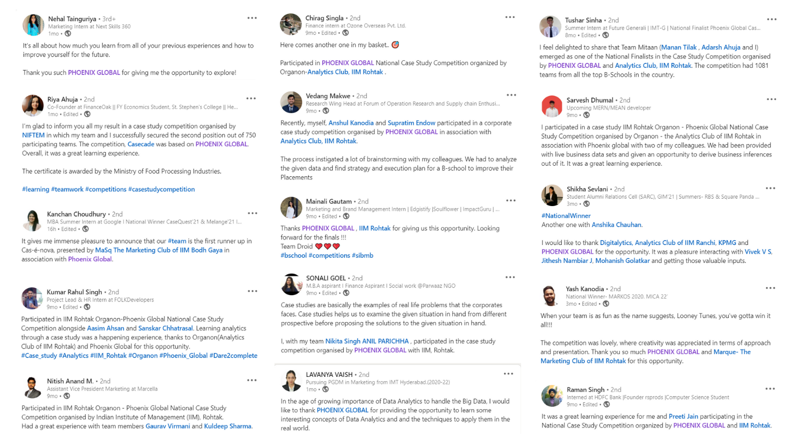
Success Stories

Slide 20
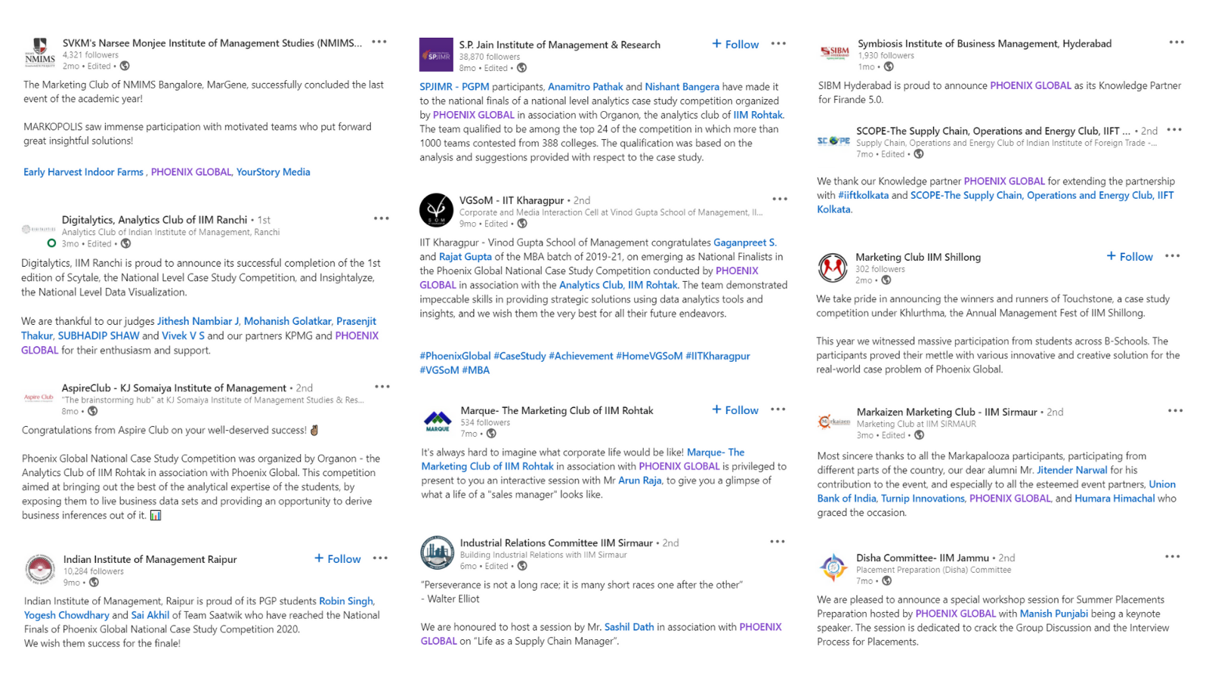
Top B-Schools mentioning Phoenix

Slide 21
Phoenix Global
CORPORATE OFFICE
Phoenix Global, 6th Floor, Omega-C Block, Divyasree Building, Hitech City Rd, Hyderabad, Telangana 500032
Web: www.phoenix-global.co.in
e-mail: corporate@phoenix-global.co.in
Landline No: 040 71055796
Fax Number: 040 71055701
24x7 WhatsApp Info Center: +91 95814 47424 (WhatsApp Texting Only)
All rights reserved. No part of this document may be reproduced or copied in any form or by any means [graphic, electronic or mechanical, including photocopying, recording, taping or information retrieval systems] or reproduced on any disc, tape, perforated media or other information storage device, etc., without the explicit written permission of Phoenix Global. Breach of the condition is liable for legal action.
Disclaimer: All product and company/Institute names/Logos/Brand Icons are trademarks™ or registered® trademarks of their respective holders. Use of them does not imply any affiliation with or endorsement by them. All specifications are subject to change without notice.

